Slide 1
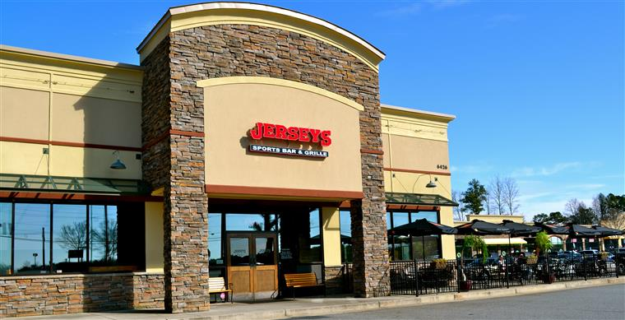
Cherokee County Republican Party
BUY A TREE BALL FOR A CHANCE TO WIN A GRAND PRIZE!
CHRISTMAS PARTY
MONDAY DEC 11TH 7-10PM
REGISTER AND PRE-PAY $10 TO ATTEND BY DEC 9TH
^{$15 AT THE DOOR}
https://ccrp.wildapricot.org/
RAFFLE PRIZES
DRINKS & GREAT FOOD
(ALCOHOL PAY AS YOU GO)
MISTLE TOE &
ALL THE TRIMMINGS!
WHITE ELEPHANT
TO PLAY:
BRING WRAPPED GIFT
< $10 VALUE
QUESTIONS? KERRY.LUEDKE@CHEROKEECOUNTYGOP.COM
OR HARRY. ABRAMS@CHEROKEECOUNTYGOP.COM OR
KEVIN WRIGHT PH (502) 649-0089
Jerseys Sports Bar & Grille
6426 Bells Ferry Road
Woodstock, GA 30189

